Slide 1
Delay Bounding Congestion Control Algorithms
Lecture 9
Subir Varma

Slide 2
Delay Bounding Algorithms
Delay bounding algorithms have been inspired by TCP Vegas
TCP Vegas gets swamped by loss based algorithms (TCP Reno and its successors), and hence for a long time this class of algorithms was not very popular.
Some popular algorithms combined delay based and loss based paradigms, such as Compound TCP and Yeah TCP.
TCP FAST was another well known algorithm that was proposed in 2004 which tried to solve some of the issues with TCP Vegas.
Over the past ten years, however, delay-bounding algorithms have experienced a resurgence with several proposals that overcome these issues, including Sprout, Remy (Lecture 10), BBR (Lecture 7), PCC (Lecture 10), Copa (this lecture), and Verus.

Slide 3
Delay Bounding Algorithms Discussed in Earlier Lectures
Combine Loss type algorithms such as CUBIC (Lecture 6) with Explicit Congestion Notification (ECN) and trigger ECNs if the bottleneck queue size exceeds a threshold. DCTCP (Lecture 8) also belongs to this class of algorithms.
AQM Algorithms that try to control bottleneck queue size by dropping packets: RED, Proportional Control, Proportional + Integral Control (all in Lecture 3), CoDel (Lecture 4).
All these algorithms try to bound delay by trying to keep the bottleneck queue size within bounds using router based AQM mechanisms.
Yeah TCP (Lecture 6)
Yeah TCP was an improvement on Vegas: Use of fast window increase rule if the queue was below threshold, and once the the threshold was exceeded, it treated the event like a packet loss and reduced its window (and thus rate). It also has a system for competing with loss based algorithms.
BBR (Lecture 7)
BBR can also be considered to be an improvement on Vegas. It tries to match transmission rate with the bottleneck bandwidth, and ignores packet losses as a measure of congestion.

Slide 4
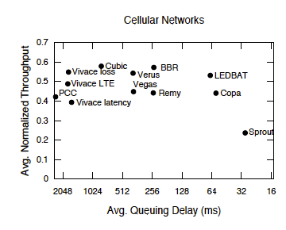
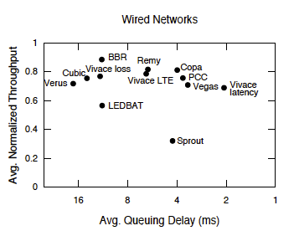
So What is Left?
We would like to optimize for throughput and delay together.
With this criteria, the best algorithms are the ones whose performance lies in the upper right corners in these graphs.
New congestion control schemes proposed in the last ten years are characterized by the fact that they take this joint constraint into account.
There is also less emphasis on being compatible with Reno or CUBIC
Experimental results from running various algorithms on live testbeds using the Pantheon framework.
“Pantheon: the training ground for Internet congestion-control research” Yan et.al. (2018)

Slide 5
Issues with Delay Based Algorithms
Delay based algorithms are very good at bounding end-to-end latency, but run into several issues in real world deployments:
How to co-exist with loss based algorithms:
When loss based algorithms overload the buffer, delay based algorithms back off
Conversely if a node is experiencing congestion losses, loss based algorithms will back off while delay based algorithms keep transmitting thus making the losses worse.
Measuring the queueing delay requires a very accurate estimate of the minimum round trip latency T.
If this estimate is not accurate, it can result in an under-estimation of the queueing delay, thus resulting in intra-protocol unfairness.
However getting an accurate estimate of T is not straightforward, it requires periodic draining of the all queues along the path.

Slide 6
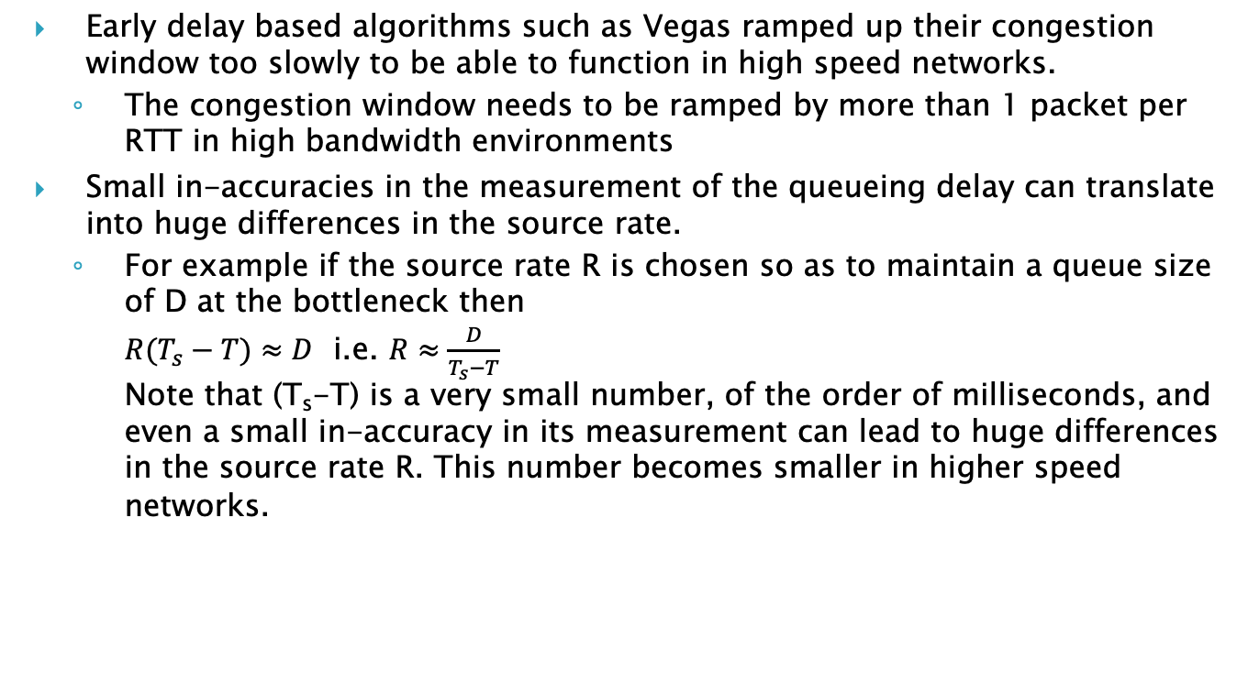
Issues with Delay Based Algorithms (cont)
Early delay based algorithms such as Vegas ramped up their congestion window too slowly to be able to function in high speed networks.
The congestion window needs to be ramped by more than 1 packet per RTT in high bandwidth environments
Small in-accuracies in the measurement of the queueing delay can translate into huge differences in the source rate.
For example if the source rate R is chosen so as to maintain a queue size of D at the bottleneck then $R(T_{s}−T)≈D$ i.e. $R≈\frac{D}{T_{s}−T}$ Note that (T_{s}-T) is a very small number, of the order of milliseconds, and even a small in-accuracy in its measurement can lead to huge differences in the source rate R. This number becomes smaller in higher speed networks.

Slide 7
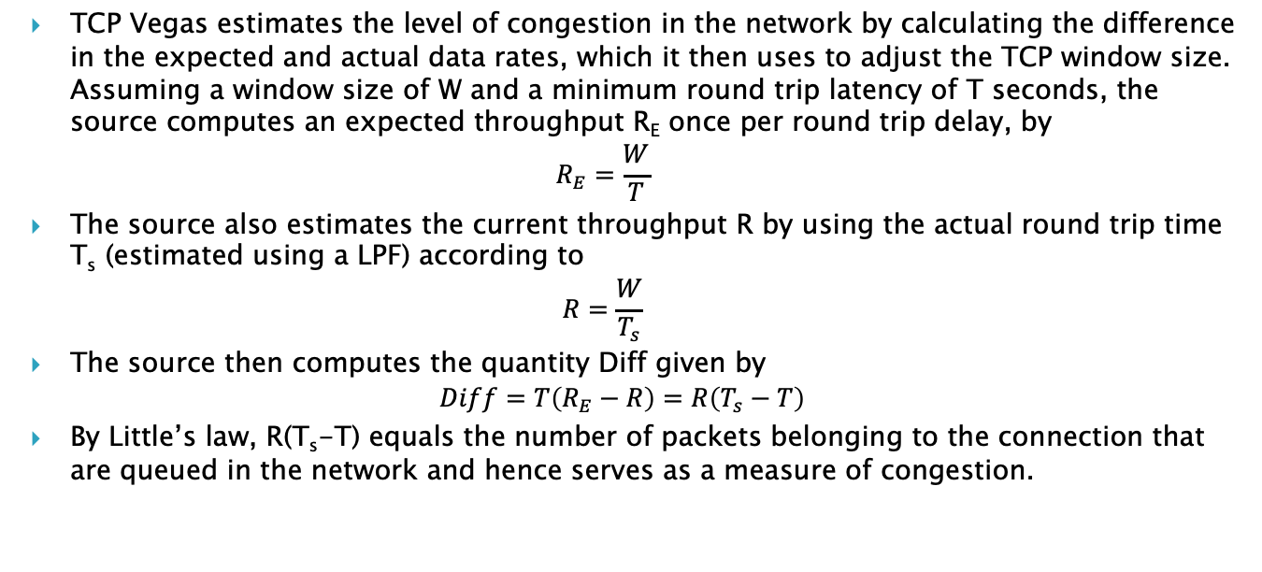
TCP Vegas: A Delay Bounding Algorithm
TCP Vegas estimates the level of congestion in the network by calculating the difference in the expected and actual data rates, which it then uses to adjust the TCP window size. Assuming a window size of W and a minimum round trip latency of T seconds, the source computes an expected throughput R_{E} once per round trip delay, by $R_{E}=\frac{W}{T}$
The source also estimates the current throughput R by using the actual round trip time T_{s} (estimated using a LPF) according to $R=\frac{W}{T_{s}}$
The source then computes the quantity Diff given by $Diff=T\left(R_{E}−R\right)=R\left(T_{s}−T\right)$
By Little’s law, R(T_{s}-T) equals the number of packets belonging to the connection that are queued in the network and hence serves as a measure of congestion.
Brakmo LS, Peterson LL. End-to-end congestion avoidance on a global Internet. IEEE JSAC
1995;13:1465-80.

Slide 8
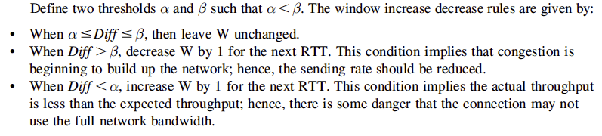
TCP Vegas: A Delay Bounding Algorithm

Slide 9
Issues with TCP Vegas
What if T is not the minimum round trip latency due to cross traffic other flows? In this case Vegas under-estimates the congestion queue length estimate Diff. In general estimating T requires that all flows synchronize themselves periodically so that there is no traffic on the links during the measurement process.
Using a LPF to measure the actual latency is also problematic: It takes time time for the filter to settle thus it cannot keep track of fast queue variations. Also it is the persistent delay that is important, not delays due to transient bursts.
The presence of other loss based flows causes Vegas to back-off, thus causing inter-protocol unfairness.
Vegas increment and decrements its window in steps of 1 packet, which is a problem in high speed links.
There is potential for un-fairness between multiple Vegas flows sharing a link (since a Vegas flow does not back-off significantly once it reaches steady state).

Slide 10
Characteristics of Delay Bounding Algorithms
Delay-bounding CCAs do not keep increasing their congestion window (cwnd) until they experience packet loss.
Instead they use the measured round-trip time (RTT) and other factors (e.g., rate estimates) to set cwnd.
They aim to achieve high utilization without bloating delays, and are also more efficient in the face of some packet loss.

Slide 11
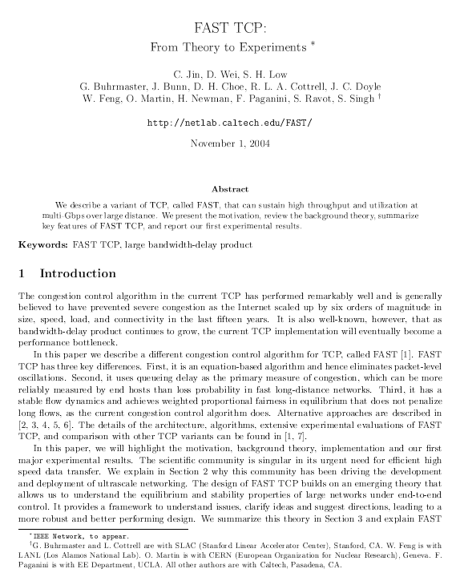
FAST TCP

Slide 12
FAST TCP
The design of FAST TCP was inspired by that of TCP Vegas. It uses end-to-end delay as a measure of congestion rather than dropped packets and can be considered to be a high speed version of Vegas.
FAST TCP has 4 components:
Estimation
Window Control
Data Control
Burstiness Control
“FAST TCP: From Theory to Experiments”, Jin et.al. (2004)

Slide 13
FAST TCP: Estimation
This component computes two pieces of information for each data packet sent:
Multi-bit Queueing delay: This is estimated by measuring the minimum RTT for a connection (called baseRTT) and also computing an exponentially smoothed average RTT (called T_{i}(t)). Note that T_{i}(t) = baseRTT + q_{i}(t), where q_{i}(t) is the queueing delay.
One-bit loss or no loss indication

Slide 14
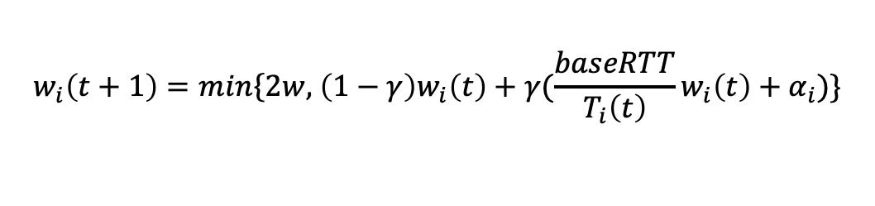

FAST TCP: Window Control
Under normal network conditions, FAST periodically updates the congestion window based on the average RTT according to
$$w_{i}\left(t+1\right)=min\left\{2w, \right.\left(1−γ\right)w_{i}\left(t\right)+γ(\frac{baseRTT}{T_{i}\left(t\right)}w_{i}\left(t\right)+α_{i})\}$$
Where $γ∈\left(0,1\right]$, and $α$ is a positive protocol parameter that determines the total number of packets queued in routers in equilibrium along the flow’s path. A typical window update period is 20 ms.
Packets are transmitted in a self clocked manner, i.e., a new packet is sent out after an ACK for a previously transmitted packet arrives, which implies that the throughput r_{i}(t) is given by $$r_{i}(t)=\frac{w_{i}(t)}{T_{i}(t)}$$
Ignoring the 2w term, the window update rule can be written as $w_{i}\left(t+1\right)$=$w_{i}\left(t\right)+γ(α_{i}−r_{i}\left(t\right)q_{i}\left(t\right))$, where
$q_{i}\left(t\right)=T_{i}\left(t\right)−baseRTT$ is the queueing delay.
Compare this with the TCP Vegas window update rule
$w_{i}\left(t+1\right)$=$w_{i}\left(t\right)+$ $\frac{1}{T_{i}(t)}$ $sgn(α_{i}(t)−r_{i}\left(t\right)q_{i}\left(t\right))$

Slide 15

FAST TCP: Window Control
While Vegas can change its window by at most 1per RTT, window adjustment in FAST depends on the magnitude (as well as sign) of the term in brackets
Hence FAST can adjust its window by a large amount, up or down, when the number of buffered packets is far away from its target, and a small amount when it is close.
FAST does not react to packet losses.

Slide 16
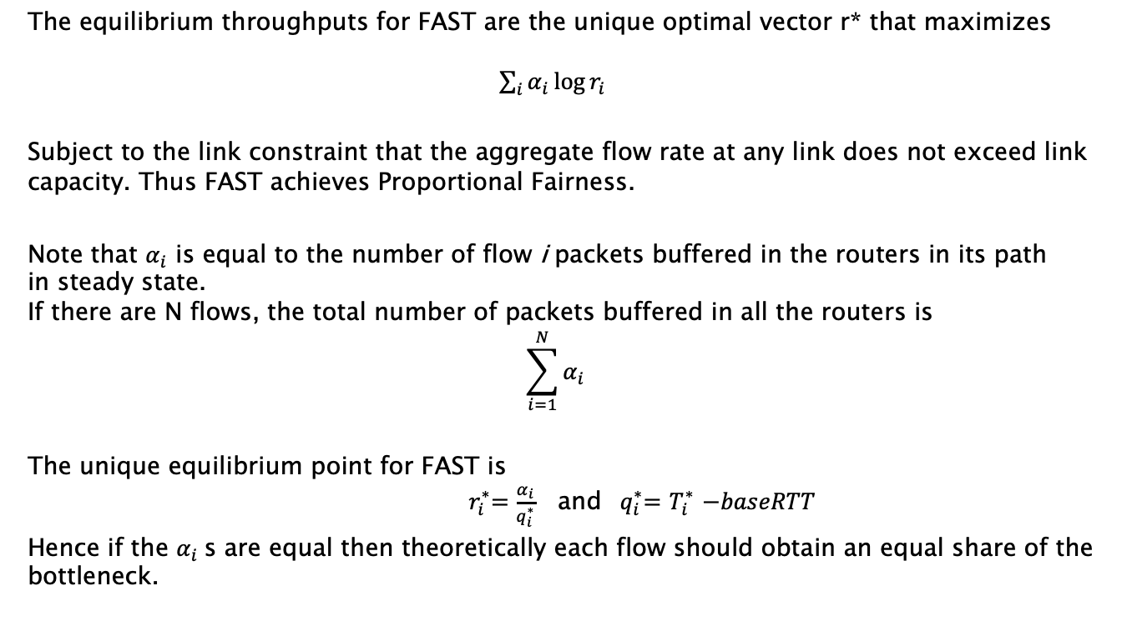
Optimization Function for FAST TCP
The equilibrium throughputs for FAST are the unique optimal vector r* that maximizes $\sum_{i}{α_{i}\log{r_{i}}}$
Subject to the link constraint that the aggregate flow rate at any link does not exceed link capacity. Thus FAST achieves Proportional Fairness.
Note that $α_{i}$ is equal to the number of flow i packets buffered in the routers in its path in steady state. If there are N flows, the total number of packets buffered in all the routers is $$\sum_{i=1}^{N}{α_{i}}$$
The unique equilibrium point for FAST is ${ r}_{i}^{∗}=\frac{α_{i}}{q_{i}^{∗}}$ and ${ q}_{i}^{∗}=$ $T_{i}^{∗}$ $−baseRTT$
Hence if the $α_{i}$s are equal then theoretically each flow should obtain an equal share of the bottleneck.

Slide 17
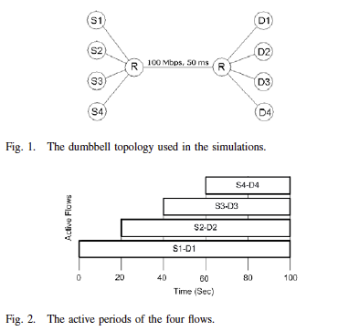
Experimental Results: Intra-Protocol Fairness
“FAST TCP: Fairness and Queueing Issues,” (2005), Tan et.al.

Slide 18
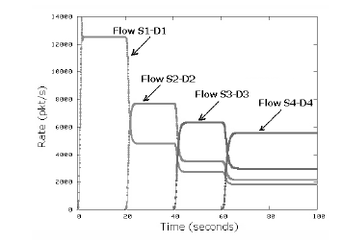
Experimental Results
Note that the value of baseRTT is set by minimum RTT observed so far. Clearly this may not be an accurate estimate of the minimum RTT.
A late joining FAST TCP flow overestimates its RTT because ALL its packets experience significant queuing delay thus its baseRTT is too high.
Therefore it underestimates its queuing delay relative to early joining FAST TCP flows. This makes the late joining flows more aggressive thus obtaining higher throughput.

Slide 19
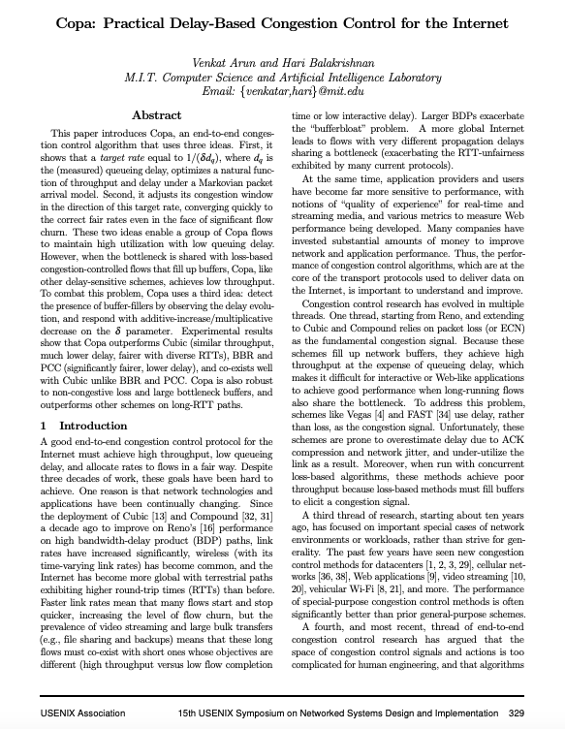
TCP COPA (2018)

Slide 20
COPA: Objective
COPA was designed with the objective of solving three of the four issues that were pointed out for delay based algorithms:
Ramping up window for high speed networks: COPA includes a mechanism for using higher window increments for high speed networks.
Competing with loss based systems: COPA is able to detect if there are competing flows at a node that are loss based, and it changes its window control algorithm appropriately.
Accurately measuring the minimum round trip delay T: The algorithm guarantees that the queue drains completely periodically, which helps to measure T.

Slide 21
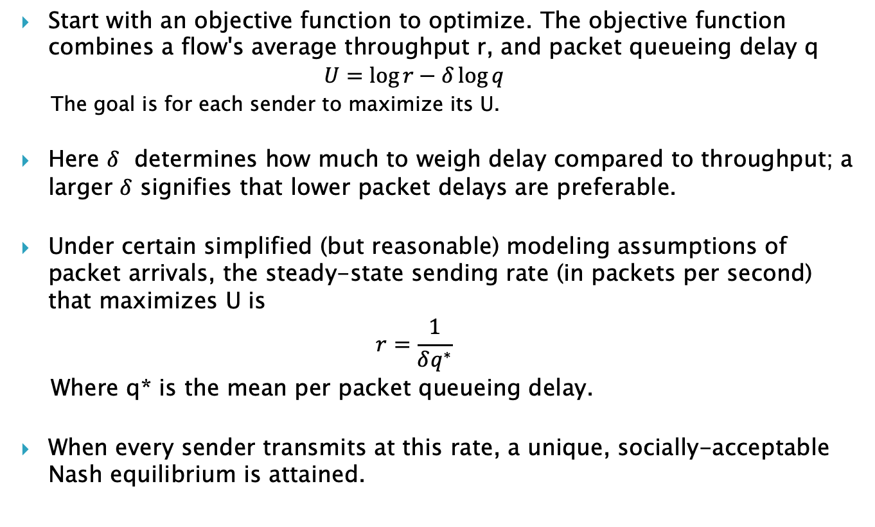
COPA: Approach
Start with an objective function to optimize. The objective function combines a flow's average throughput r, and packet queueing delay q $U=\log{r−δ\log{q}}$
The goal is for each sender to maximize its U.
Here $δ$ determines how much to weigh delay compared to throughput; a larger $δ$ signifies that lower packet delays are preferable.
Under certain simplified (but reasonable) modeling assumptions of packet arrivals, the steady-state sending rate (in packets per second) that maximizes U is $r=\frac{1}{δq^{∗}}$
Where q* is the mean per packet queueing delay.
When every sender transmits at this rate, a unique, socially-acceptable Nash equilibrium is attained.

Slide 22

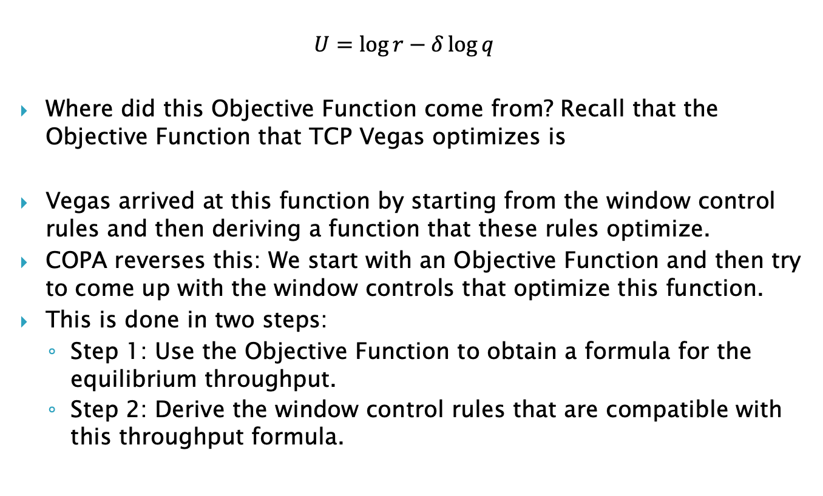
COPA Objective Function
$$U=\log{r−δ\log{q}}$$
Where did this Objective Function come from? Recall that the Objective Function that TCP Vegas optimizes is
Vegas arrived at this function by starting from the window control rules and then deriving a function that these rules optimize.
COPA reverses this: We start with an Objective Function and then try to come up with the window controls that optimize this function.
This is done in two steps:
Step 1: Use the Objective Function to obtain a formula for the equilibrium throughput.
Step 2: Derive the window control rules that are compatible with this throughput formula.

Slide 23

COPA Step 1: Target Rate
This rate is used as the target rate for a Copa sender. The sender estimates the queuing delay using its RTT observations, and moves quickly toward hovering near this target rate.
This mechanism induces a property that the queue is regularly almost flushed every 5RTT, which helps all endpoints get a correct estimate of the minimum RTT.
Note that since COPA does not react to packet losses, it may unfairly hog the bandwidth when competing with buffer filling type flows (which happens with BBR). In order to prevent this, Copa mimics an AIMD window-update rule when it observes that the bottleneck queues rarely empty (similar to Yeah TCP).

Slide 24
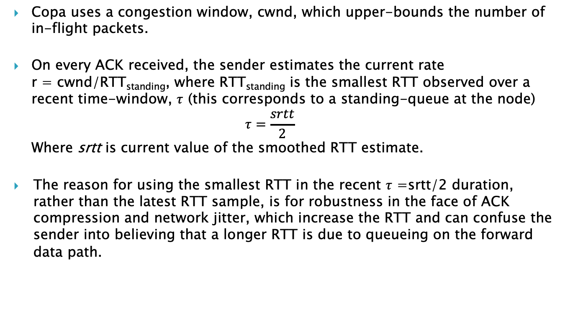
COPA Step 2: cwnd Updating Rule
Copa uses a congestion window, cwnd, which upper-bounds the number of in-flight packets.
On every ACK received, the sender estimates the current rate r = cwnd/RTT_{standing}, where RTT_{standing} is the smallest RTT observed over a recent time-window, $τ$ (this corresponds to a standing-queue at the node) $τ=\frac{srtt}{2}$
Where srtt is current value of the smoothed RTT estimate.
The reason for using the smallest RTT in the recent $τ$ =srtt/2 duration, rather than the latest RTT sample, is for robustness in the face of ACK compression and network jitter, which increase the RTT and can confuse the sender into believing that a longer RTT is due to queueing on the forward data path.
RTT_{standing} is smallest RTT over this period
srtt/2
Packet Tx
ACK Rx

Slide 25

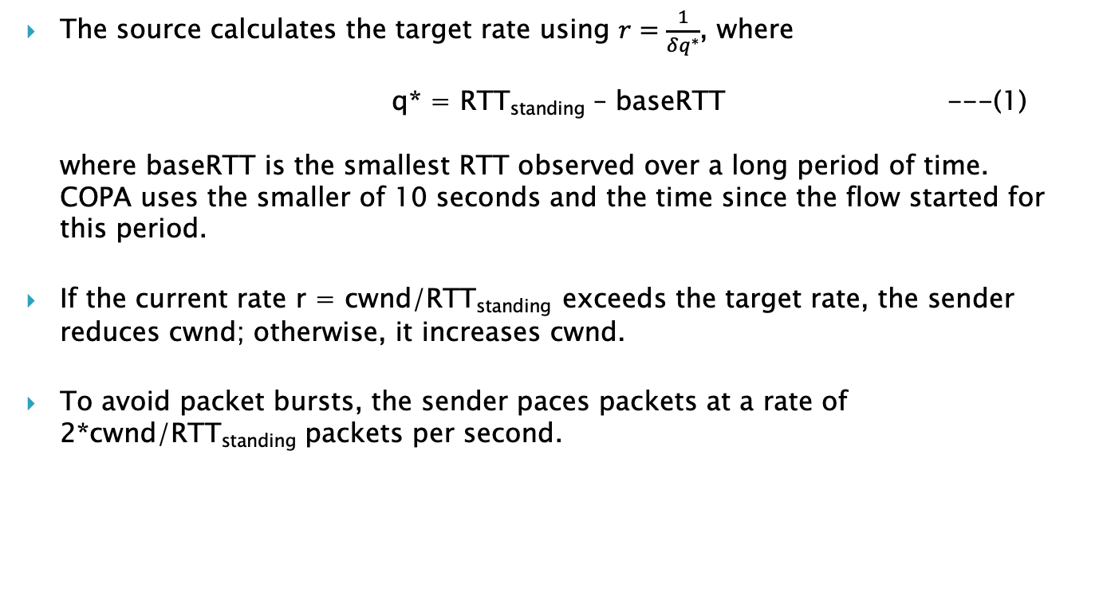
COPA Step 2: cwnd Updating Rule
The source calculates the target rate using $r=\frac{1}{δq^{∗}}$, where q* = RTT_{standing} – baseRTT ---(1) where baseRTT is the smallest RTT observed over a long period of time. COPA uses the smaller of 10 seconds and the time since the flow started for this period.
If the current rate r = cwnd/RTT_{standing} exceeds the target rate, the sender reduces cwnd; otherwise, it increases cwnd.
To avoid packet bursts, the sender paces packets at a rate of 2*cwnd/RTT_{standing} packets per second.
$\frac{1}{δ}$ is in units of MTU sized packets

Slide 26

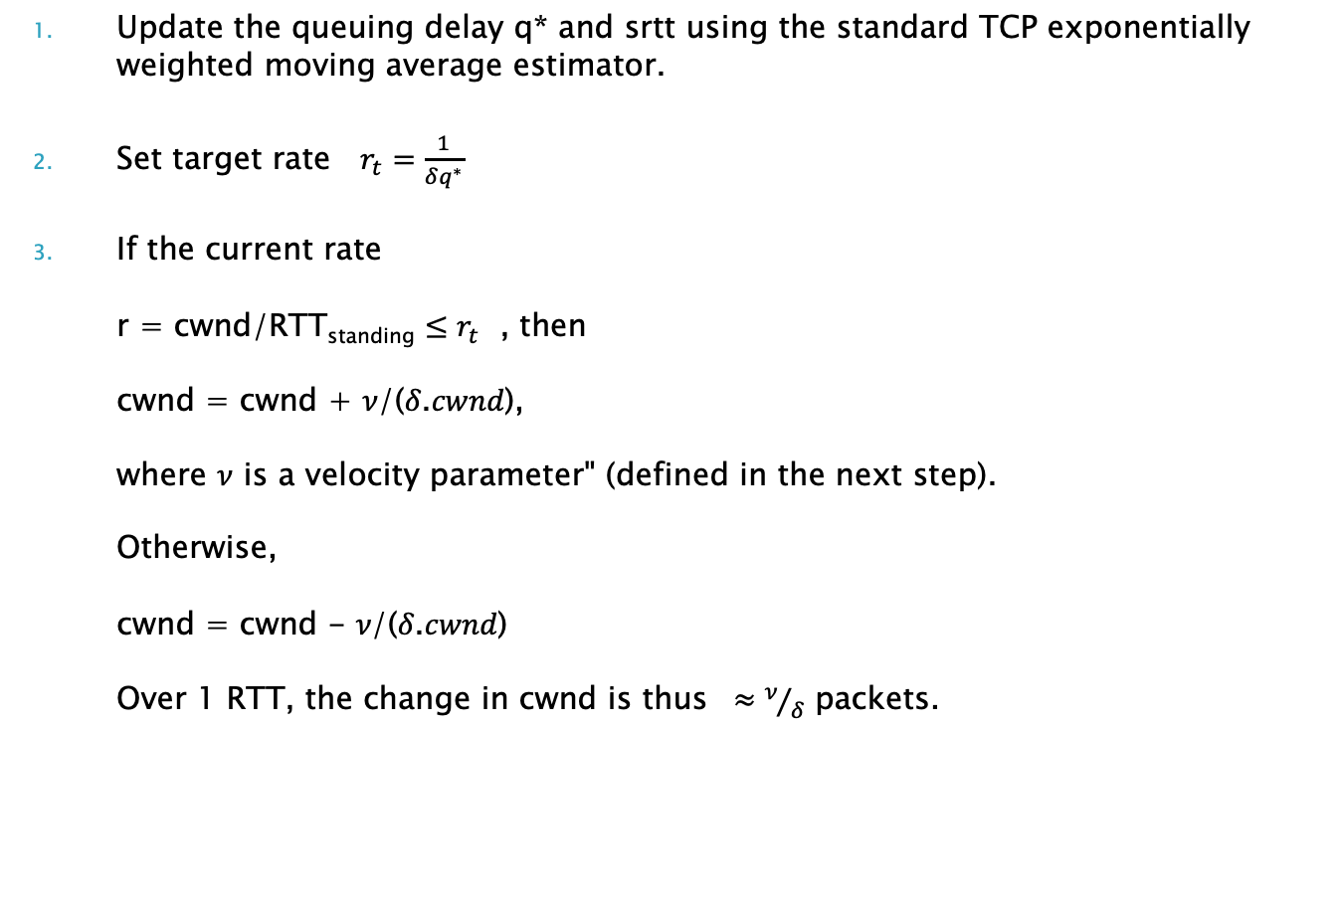
Window Update On Every ACK Arrival
Update the queuing delay q* and srtt using the standard TCP exponentially weighted moving average estimator.
Set target rate $r_{t}=\frac{1}{δq^{∗}}$
If the current rate r = cwnd/RTT_{standing} $≤r_{t}$ , then cwnd = cwnd + 𝜈/(𝛿.𝑐𝑤𝑛𝑑), where $ν$ is a velocity parameter" (defined in the next step). Otherwise, cwnd = cwnd - 𝜈/(𝛿.𝑐𝑤𝑛𝑑) Over 1 RTT, the change in cwnd is thus $≈ν/δ$ packets.

Slide 27
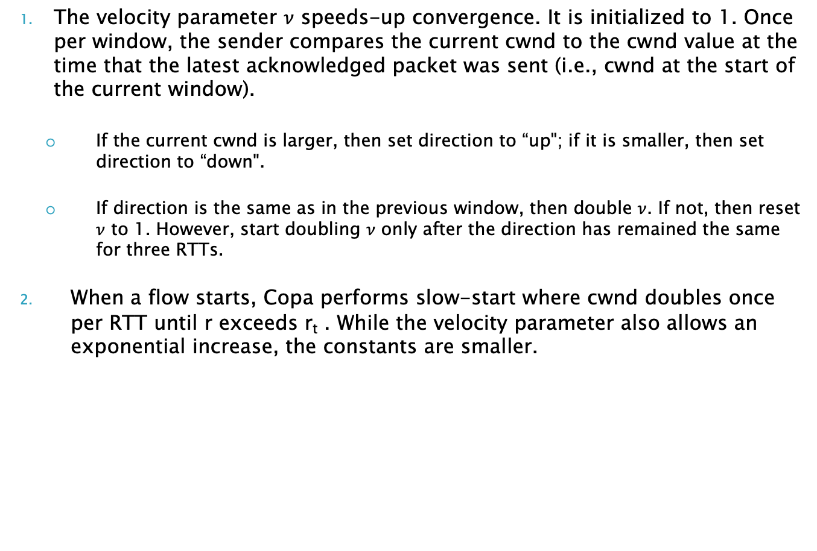
Window Update (cont)
The velocity parameter $ν$ speeds-up convergence. It is initialized to 1. Once per window, the sender compares the current cwnd to the cwnd value at the time that the latest acknowledged packet was sent (i.e., cwnd at the start of the current window).
If the current cwnd is larger, then set direction to “up"; if it is smaller, then set direction to “down".
If direction is the same as in the previous window, then double $ν$. If not, then reset $ν$ to 1. However, start doubling $ν$ only after the direction has remained the same for three RTTs.
When a flow starts, Copa performs slow-start where cwnd doubles once per RTT until r exceeds r_{t} . While the velocity parameter also allows an exponential increase, the constants are smaller.

Slide 28
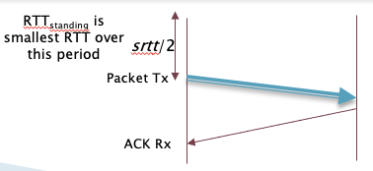
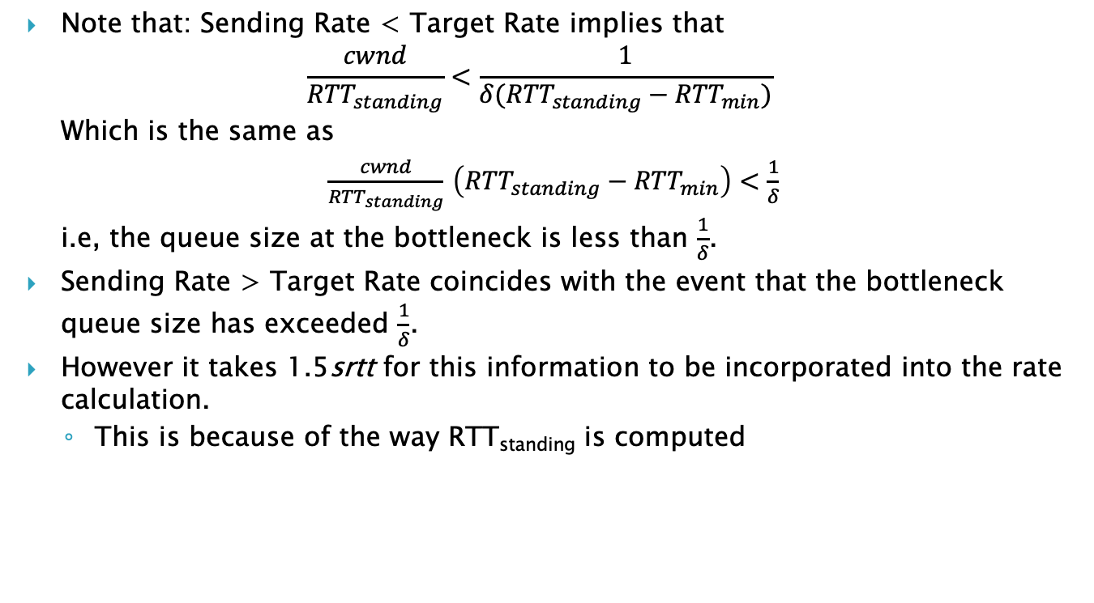
COPA in Steady State
Note that: Sending Rate < Target Rate implies that
$$\frac{cwnd}{{RTT}_{standing}}<\frac{1}{δ({RTT}_{standing}−{RTT}_{min})}$$
Which is the same as
$\frac{cwnd}{{RTT}_{standing}}$ $\left({RTT}_{standing}−{RTT}_{min}\right)<\frac{1}{δ}$
i.e, the queue size at the bottleneck is less than $\frac{1}{δ}$.
Sending Rate > Target Rate coincides with the event that the bottleneck queue size has exceeded $\frac{1}{δ}$.
However it takes 1.5srtt for this information to be incorporated into the rate calculation.
This is because of the way RTT_{standing} is computed
RTT_{standing} is the smallest RTT observed over a recent time-window

Slide 29
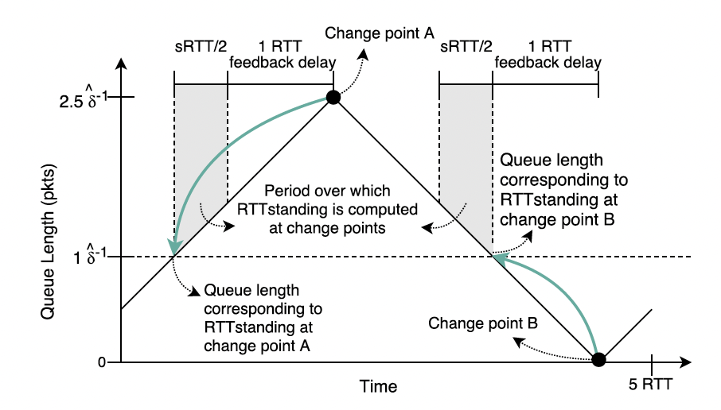
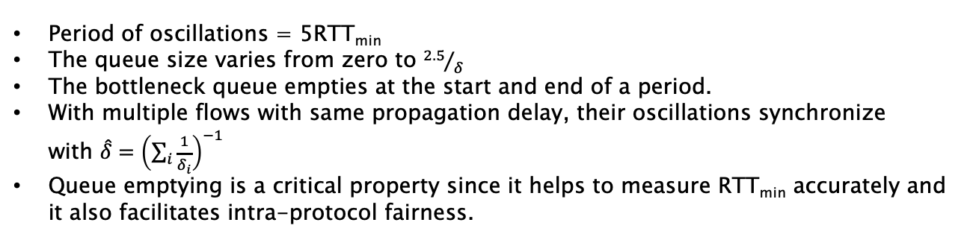
Steady State Oscillations
Period of oscillations = 5RTT_{min}
The queue size varies from zero to ${2.5}/δ$
The bottleneck queue empties at the start and end of a period.
With multiple flows with same propagation delay, their oscillations synchronize with $\hat{δ}={\left(\sum_{i}{\frac{1}{δ_{i}}}\right)}^{−1}$
Queue emptying is a critical property since it helps to measure RTT_{min} accurately and it also facilitates intra-protocol fairness.

Slide 30
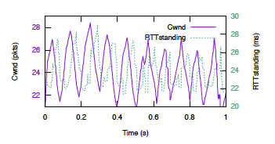
COPA Window Evolution
The period of oscillation is 5RTT and amplitude is 5 packets (since $δ=0.5)$.

Slide 31
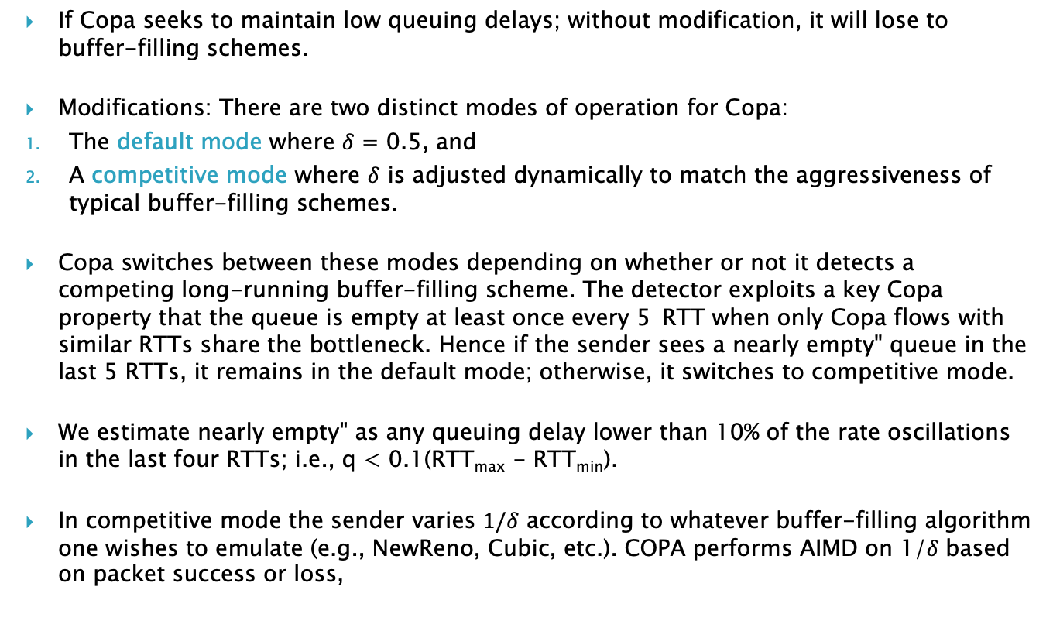
Competing with Buffer Based Algorithms
If Copa seeks to maintain low queuing delays; without modification, it will lose to buffer-filling schemes.
Modifications: There are two distinct modes of operation for Copa:
The default mode where 𝛿 = 0.5, and
A competitive mode where $δ$ is adjusted dynamically to match the aggressiveness of typical buffer-filling schemes.
Copa switches between these modes depending on whether or not it detects a competing long-running buffer-filling scheme. The detector exploits a key Copa property that the queue is empty at least once every 5 RTT when only Copa flows with similar RTTs share the bottleneck. Hence if the sender sees a nearly empty" queue in the last 5 RTTs, it remains in the default mode; otherwise, it switches to competitive mode.
We estimate nearly empty" as any queuing delay lower than 10% of the rate oscillations in the last four RTTs; i.e., q < 0.1(RTT_{max} - RTT_{min}).
In competitive mode the sender varies $1/δ$ according to whatever buffer-filling algorithm one wishes to emulate (e.g., NewReno, Cubic, etc.). COPA performs AIMD on 1/𝛿 based on packet success or loss,
Over 1 RTT the change in cwnd is $1/δ$ packets

Slide 32
COPA Performance
COPA performance:
COPA exhibits higher intra-protocol fairness compared to Cubic and BBR.
COPA achieved as a much throughput and 2-10x lower queueing delays compared to Cubic and BBR.
In datacenter network simulations, on a web search workload trace drawn from datacenter network, Copa achieved a > 5x reduction in flow completion time for short flows over DCTCP. It achieved similar performance for long flows.
In experiments on an emulated satellite path, Copa achieved nearly full link utilization with a median queuing delay of only 1 ms. BBR obtained 50% link utilization. Both Cubic and Vegas obtained < 4% utilization.
COPA also exhibits better RTT fairness.

Slide 33
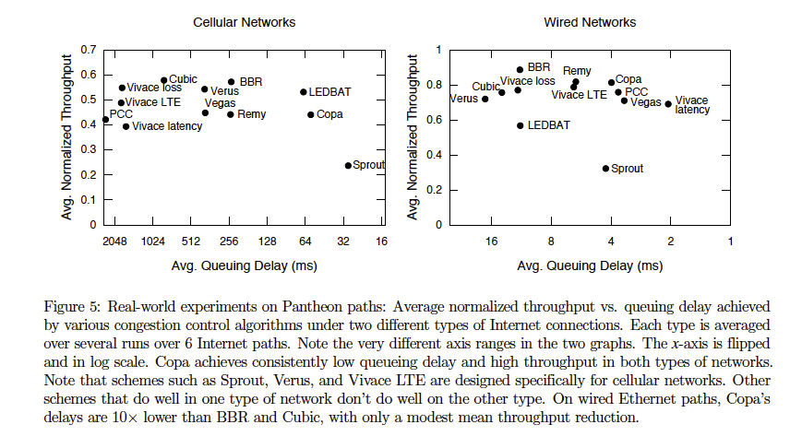
COPA Performance

Slide 34
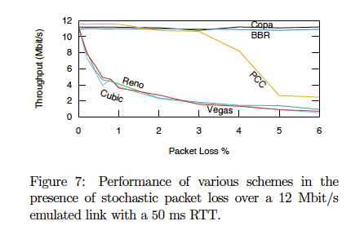
COPA Performance with Link Loss

Slide 35
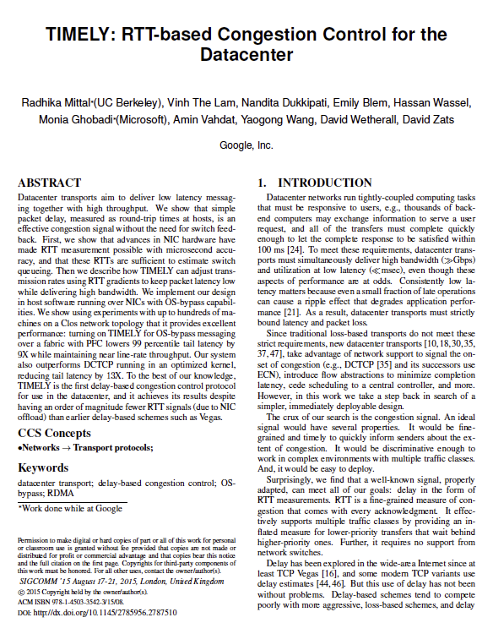
TIMELY

Slide 36
TIMELY Congestion Control
Specialized for Data Center environments
Uses very precise measurements for round trip latency, made possible by advances in NIC Card technology
Uses a Rate Based congestion control algorithm
Uses a combination of Delay AND Delay Gradients to keep queue size within a tight range.
Requires no switch support, purely end-to-end based

Slide 37
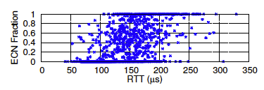
Delay based Algorithms in the Data Center
Delay had not been used as a congestion signal in the datacenter because datacenter RTTs are difficult to measure at microsecond granularity. This level of precision is easily overwhelmed by host delays such as interrupt processing for acknowledgments.
However recent NIC advances do allow datacenter RTTs to be measured with sufficient precision. They provide hardware support for high-quality timestamping of packet events plus hardware-generated ACKs that remove unpredictable host response delays.
Using RTTs provides richer and faster information about the state of network switches than explicit network switch signals such as ECN marks. The ECN signal does not correlate well with RTT and hence with the amount of queuing.

Slide 38
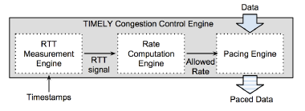
TIMELY Protocol
TIMELY has 3 components
RTT measurement to monitor the network for congestion
A computation engine that converts RTT signals into target sending rates
A control engine that inserts delays between segments to achieve the target rate.

Slide 39
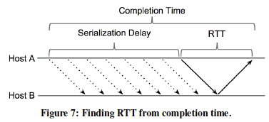

RTT Measurement Engine
A segment consisting of multiple packets is sent as a single burst and then ACKed as a unit by the receiver. A completion event is generated upon receiving an ACK for a segment of data and includes the ACK receive time.
The time from when the first packet is sent (t_{send}) until the ACK is receive (t_{completion}) is defined as the completion time.
Propagation
Delay
Serialization
Delay

Slide 40
TIMELY Congestion Control
The rate computation engine runs the congestion control algorithm upon each completion event, and outputs an updated target rate for the flow.
TIMELY does not try to control the queueing delay directly since it has been shown that it is not possible to control the queue size when it is shorter in time than the control loop delay.
TIMELY’s congestion controller achieves low latencies by reacting to the delay gradient or derivative of the queuing with respect to time, instead of trying to maintain a standing queue.
This is possible because TIMELY can accurately measure differences in RTTs that indicate changes in queuing delay.
A positive delay gradient due to increasing RTTs indicates a rising queue, while a negative gradient indicates a receding queue.
By using the gradient, TIMELY can react to queue growth without waiting for a standing queue to form – a strategy that helps us achieve low latencies.

Slide 41
Delay Gradients
Delay gradient is a proxy for the rate mismatch at the bottleneck queue. RCP, XCP etc have shown that explicit feedback on the rate mismatch has better stability and convergence properties than explicit feedback based only on queue sizes.
Denote the queuing delay through the bottleneck queue by q(t). If y(t) > C, the rate at which the queue builds up is (y(t) - C). Since queued data drains at a rate C, the queuing delay gradient is given by
Hence, the delay gradient measured through RTT signals acts as an indicator for the rate mismatch at the bottleneck.

Slide 42
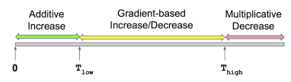
Timely Congestion Control
Use gradient based rate increase and decrease in this region
Use latency based rate increase in this region
Use latency based rate decrease in this region
The T_{low} and T_{high} thresholds effectively bring the delay within a target range and play a role similar to the target queue occupancy in many AQM schemes.
Using the delay gradient improves stability and helps keep the latency within the target range [T_{low}, T_{high}].

Slide 43
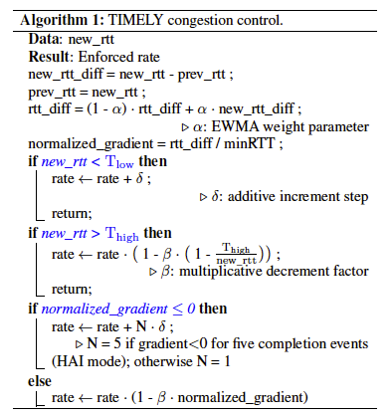
Timely Congestion Control
Filtered estimate of Delay Gradient
If the gradient is negative or equals zero, the network can keep up with the aggregate incoming rate, and therefore
there is room for a higher rate.
When the gradient is positive, the
total sending rate is greater than network capacity. Hence,
TIMELY performs a multiplicative rate decrement, scaled
by the gradient factor:

Slide 44
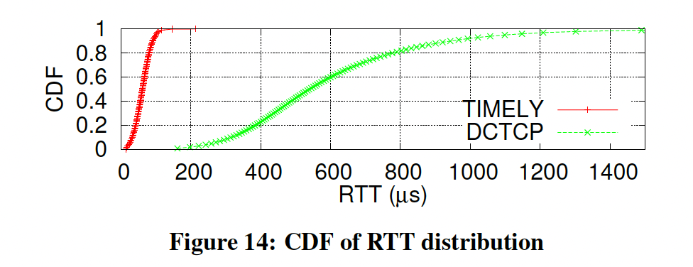
Comparison with DCTCP
TIMELY keeps the average end-to-end RTT 10X lower than DCTCP (60 s vs. 600 s).
More significantly, the tail latency drops by almost 13X (116 s vs. 1490 s).

Slide 45
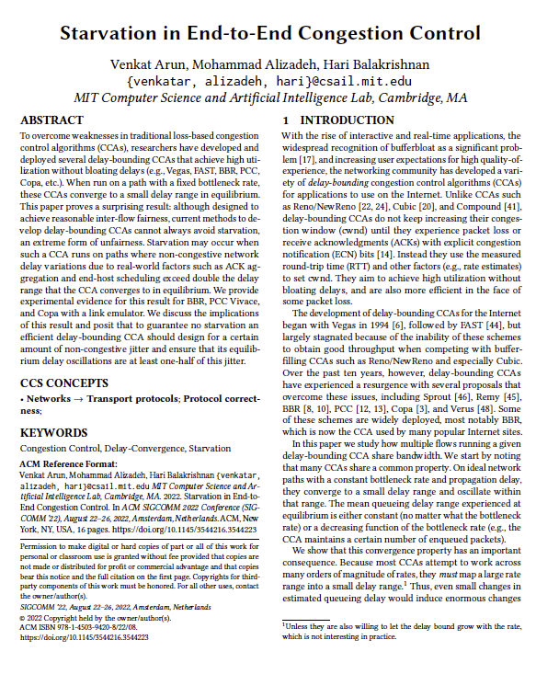
Issues with Delay Bounding Schemes (2022)

Slide 46
Objective
The paper focuses on how multiple flows running a given delay-bounding CCA share bandwidth.
The problem the authors identified is the following: Because most CCAs attempt to work across many orders of magnitude of rates, they must map a large rate range into a small delay range. Thus, even small changes in estimated queueing delay would induce enormous changes in the inferred rate.
Can perfect measurements solve the problem:
No, since there is no way to precisely measure congestive queueing delays. The reason is that non-congestive (i.e., non-bottleneck-queueing) contributions to network delay are rarely constant in practice, and hard to separate from congestion.
Due to effects such as ACK aggregation, delayed ACKs, end-host operating system or thread scheduling, token bucket filters, hardware offload timing variations, etc., packets experience jitter on network paths unrelated to bottleneck queueing.
Hence they focus on understanding the effects of non-congestive jitter on delay-bounding CCAs, expecting some degree of unfairness and hoping to quantify it as a function of the delay jitter.

Slide 47
Main Results
Efficient delay-bounding CCAs that converge in steady state to a bounded delay range are not merely unfair, but cannot avoid starvation.
When two flows using the same CCA share a bottleneck link, if the non-congestive delay variations exceed double the difference between the maximum and minimum queueing delay at equilibrium, then there are patterns of non-congestive delay where one flow will get arbitrarily low throughput compared to the other.
Congestion Control Algorithms can target at most two out of the following three properties:
High throughput,
Convergence to a small and bounded delay range, and
No starvation.
Are we are doomed to choose between bounding delays and avoiding starvation?
We might be able to achieve both desirable goals by being explicit about non-congestive delays in CCA design, ensuring that the CCA’s delay variations in equilibrium are at least half as as large as the non-congestive jitter expected along a path.
If that is not the case, then the results prove that starvation is inevitable.

Slide 48
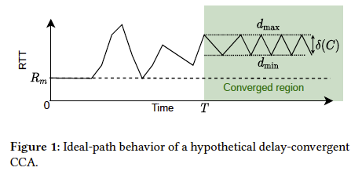
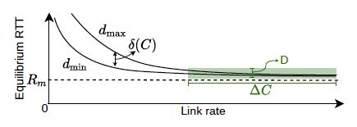
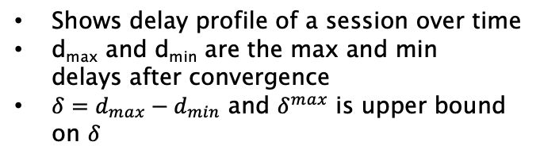
Results (cont)
Shows delay profile of a session over time
d_{max} and d_{min} are the max and min delays after convergence
$δ=d_{max}−d_{min}$ and $δ^{max}$ is upper bound on $δ$
CCAs that ensure a smaller 𝛿_{max} and hence are “more convergent” are more susceptible to starvation.
Starvation can occur if the delay ambiguity caused by non-congestive jitter delay is > 2𝛿_{max}.
For many CCAs, 𝛿_{max} is small because they strive to keep delay variations small compared to 𝑅_{𝑚}. Hence even a little ambiguity can cause starvation.
Variation of 𝛿 (𝐶) with C

Slide 49
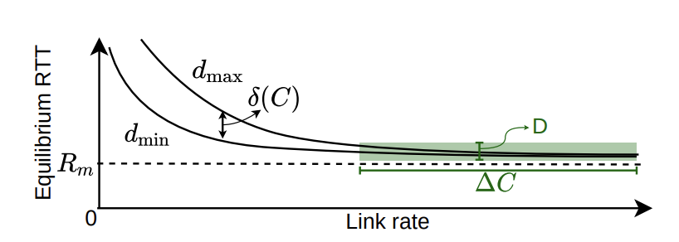
Results (cont)
𝛿 (𝐶) is 0 for Vegas, FAST, and BBR in cwnd limited mode
4𝛼/𝐶 for Copa, where 𝛼 is the packet size
𝑅𝑚/4 for BBR in pacing mode
𝑅𝑚/20 for PCC Vivace
ALL these protocols suffer from starvation even in simple two-flow scenarios with small non-congestive jitter
Variation of delays with link rate for a fixed Rm

Slide 50
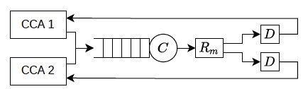
Network Model
Random delay between 0 and D
Non-congestive delays create ambiguity about the amount of queueing delay at the bottleneck.
For example, when a CCA measures an RTT increase of Δ𝑑=5 it only knows that the increase due to congestion is between Δ𝑑−𝐷 and Δ𝑑.
This ambiguity creates confusion at the sender. If the delay observed is truly caused by congestion, the CCA should reduce its rate, but if it does so and the delay turns out to be non-congestive, it may under-utilize the network.
When flows sharing a link estimate the queueing delay differently, they may send at unequal rates, which can cause starvation

Slide 51
An Example
Consider a CCA such as Vegas or FAST that seeks to maintain 𝛼 packets in the queue per flow in equilibrium where 𝛼 is a parameter of the algorithm (e.g., 𝛼 = 4 packets).
Over an ideal path, once the CCA hits this target, its rate stabilizes and the queue length never changes. Hence 𝛿_{𝑚𝑎𝑥} = 0 and the RTT is 𝑅_{𝑚} + 𝛼/𝐶
To achieve this equilibrium, the CCA must measure the queueing delay with high precision. For example, with 𝛼 = 4 and a packet size of 1500 bytes, 𝛼/𝐶 = 0.5 ms for 𝐶 = 96 Mbit/s and 0.05 ms for 𝐶 = 960 Mbit/s.
Thus a difference of only 0.45 ms in the estimated queueing delay can cause the CCA to vary its sending rate by 10×!
Therefore, if the delay measurement ambiguity exceeds this amount, it can easily cause severe unfairness. Delay jitter of tens of milliseconds occur on Wi-Fi and cellular links.
Any delay-convergent CCA that seeks to bound delay variation below the level of jitter (delay ambiguity) of the network will suffer from the same problem.
The fundamental issue is that very different link rates are consistent with similar delay measurements. When different flows experience different non-congestive delays, they can infer very different link rates, causing unfairness and starvation.

Slide 52
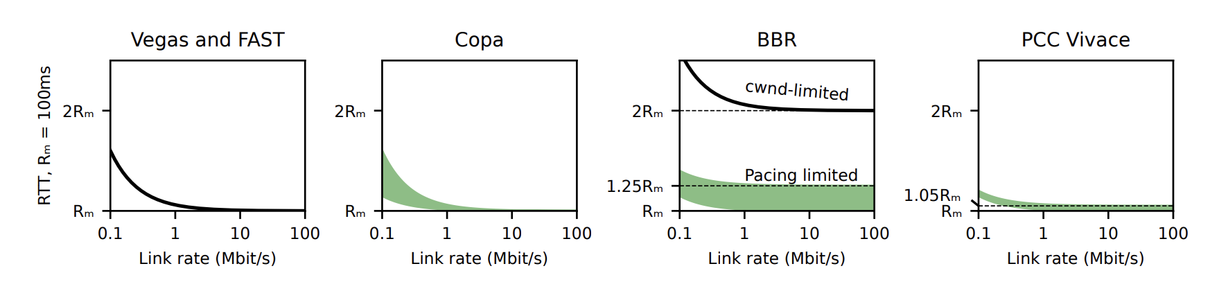
Delay Variations for Some CCAs

Slide 53
To Avoid Starvation
To utilize the link efficiently, a CCA must maintain a queue that is larger than the non-congestive delay on the path;
This alone is not enough to avoid starvation, but in addition the variation in the queueing delay in steady state must also be greater than one-half of the delay jitter;
If we have a prior upper bound on sending rate, we may be able to avoid starvation while also reducing the queueing delay variation.
Loss based algorithms actually satisfy these requirements, but the tradeoff is that delay is no longer small or bounded

